Slide 1



CENTER FOR DEVELOPMENT OF ADVANCED COMPUTING
PATNA,BIHAR
AN ABSTRACT FOR STOCK PRICE PREDICTIONS USING AIRFLOW, MACHINE LEARNING AND FLASK FRAME WORK
BY :
RACHIT MOGHE : 220980725001
NITISH KUMAR : 220980725003
SAI SIDHARTHA : 220980725005
SHREYA HOTE : 220980725006
UNDER THE GUIDENCE OF :
RANJAN SINHA SIR

Slide 2
AGENDA
INTRODUCTION
PROBLEM STATEMENT
METHODOLOGY (TOOLS USED)
TARGET TO BE ACHIEVED
STEPS FOR THE PROJECT
IMPLEMENTATION
RESULTS AND CONCLUSION
REFERENCES

Slide 3
INTRODUCTION
Stocks : A stock, also known as equity, is a security that represents the ownership of a fraction of the issuing corporation. Units of stock are called "shares" which entitles the owner to a proportion of the corporation's assets and profits equal to how much stock they own.
Shares : A person who owns a percentage of the stock has the ownership of the corporation proportional to their share. The shares form a stock.
How is stock price predicted ?
Multiple Ways are there in the market in order to predict the stock price so majorly are based upon the past data which has occurred days or weeks or a monthly . According to this the data is collected and thus calculated with the time series and time to time and make investor work easy !
Who helps in predicting the stocks from time to time ?
As we have discussed it’s a time series analysis it calculated upon its past data so as to this the investor doesn’t get a direct idea about it there are people who rely on stocks and give predictions to the investor those people are called as brokers . An investor should pay the brokers called as Brokerage that is demanded by the concern broker.
Now as the technology has improved a lot by a large margin one investor doesn’t rely upon the broker in order to invest in the market !
Here our abstract will have a user interface in order to which with the help of that interface an investor can get a clean idea on the stock price.
To get to know more lets start !!

Slide 4
PROBLEM STATEMENT:
The stock market appears in the news every day. You hear about it every time it reaches a new high or a new low. The rate of investment and business opportunities in the Stock market can increase if an efficient algorithm could be devised to predict the short term price of an individual stock.
In this Project we are going to create an abstract by extracting the data from airflow store it in Mongo DB perform data analysis and create several machine learning models then create a web application for user interface

Slide 5
Methodology and Tools
Data Extraction and processing (APACHE AIRFLOW (DAGS))
Data Storage (CSV format , MONGO DB)
Exploratory Data Analysis and MACHINE LEARNING models (Python)
MACHINE LEARNING (Linear Regression, Support vector machine, random Forest, Decision trees, Knearest Neighbor, LSTM)
Flask Framework (FLASK library in PYTHON)
OPERATING SYSTEM USED :
LINUX OS ( Apache Airflow and mongo DB)
WINDOWS (EDA n MACHINE Learning(Jupyter Notebook IDE))
* All python operations were done on windows

Slide 6
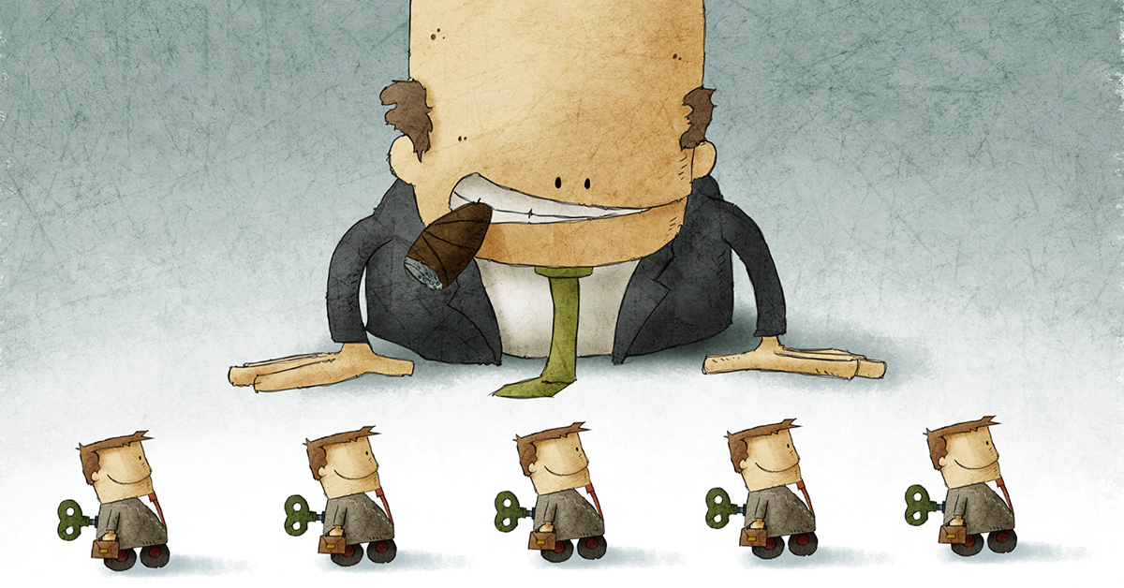

Target To Be Achieved
Before we were talking about the Brokerage ! The main disadvantages of brokerage is that it is not affordable for every investor he/she might always should rely on them for the future predictions !!
So , Here we are Going to create a user interface Web
Application with the help of FLASK framework and we
Make the investor work more easy to get rid of the brokers
The process for this is :
DATA COLLECTION AND PROCCESSING ALSO STORAGE(APACHE AIRFLOW ,Pyspark, MONGODB)
EXPLORATORY DATA ANALYSIS
MACHINE LEARNING MODEL (Linear Regression, SVM, KNN, Random forest, Decision tree , LSTM)
Flask Frame work for web application

Slide 7

Step1 : Data Extraction and Processing
APACHE AIRFLOW :Apache Airflow is an open-source workflow management platform for data engineering pipelines. It started at Airbnb in October 2014 as a solution to manage the company's increasingly complex workflows. Creating Airflow allowed Airbnb to programmatically author and schedule their workflows and monitor them via the built-in Airflow user interface. From the beginning, the project was made open source, becoming an Apache Incubator project in March 2016 and a top-level Apache Software Foundation project in January 2019.
DAGS : A graph is formed by vertices and by edges connecting pairs of vertices, where the vertices can be any kind of object that is connected in pairs by edges. In the case of a directed graph, each edge has an orientation, from one vertex to another vertex. A path in a directed graph is a sequence of edges having the property that the ending vertex of each edge in the sequence is the same as the starting vertex of the next edge in the sequence; a path forms a cycle if the starting vertex of its first edge equals the ending vertex of its last edge. A directed acyclic graph is a directed graph that has no cycles.
The process is that here in the DAGs we write a code and start the DAGs in the localhost:8080 and we can start the DAG that will perform the stocks data which is i.e Closed , opened and ended so these data is very important in order to provide the future stock important
The DAG code which we used in these project is the Python code and it is saved in YML format that is read by the DAG of Airflow pipeline.
In the next slides we would see how the Data is extracted with the help of Python Code.

Slide 8

Step 2 : Data Storage
MongoDB is a source-available cross-platform document-oriented database program. Classified as a NoSQL database program, MongoDB uses JSON-like documents with optional schemas. MongoDB is developed by MongoDB Inc. and licensed under the Server Side Public License (SSPL) which is deemed non-free by several distributions. MongoDB is a member of the MACH Alliance.
After the DAG initiated the output of the data we have stored in Mongo DB a NoSQL data base where the data is stored in CSV (comma separated file) format and also key value pair .
So the data is extracted from the airflow pipeline and thus it is stored in the data base
In this data base the data is stored under the collections format as it is a document oriented database .
This data will be updated with every 15 minutes with time and date mentioned in the given dag code

Slide 9
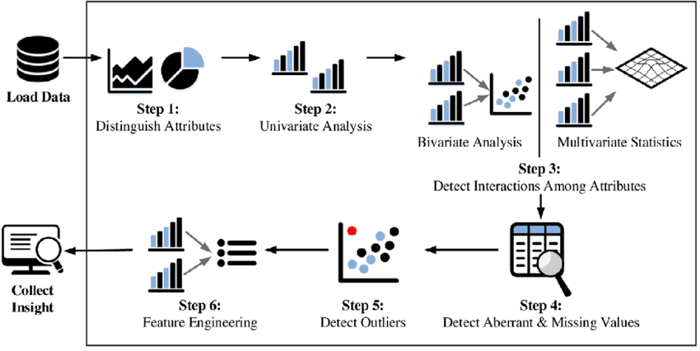

Step 3 : Exploratory Data Analysis
PLATFORM :
Picture credits : https://images.app.goo.gl/ScGnK91nCtgmPeiDA
https://images.app.goo.gl/jKSemZXF4SAGdwPz9

Slide 10
Step 4 : MACHINE LEARNING MODELS
LINEAR REGRESSION : Linear regression is a statistical method used to model the relationship between a dependent variable (also known as the response variable) and one or more independent variables (also known as predictor variables). The goal of linear regression is to find the best fitting line (or hyperplane in higher dimensions) that describes the relationship between the variables.
Linear regression can be extended to multiple independent variables, resulting in a multiple linear regression model. The equation for this model is similar to the simple linear regression model, but includes multiple predictor variables and coefficients.
Linear regression is commonly used in many fields, such as finance, economics, psychology, and engineering, to model and predict relationships between variables.
PYTHON USE : from sklearn.linear_model import LinearRegression
Note : SKLEARN is a statistical and machine learning algorithms library used in data analysis and machine learning!
SUPPORT VECTOR MACHINE : SVM stands for Support Vector Machine, which is a supervised learning algorithm used for classification and regression analysis. SVM works by finding the best separating hyperplane between different classes in the feature space.
In SVM, each data point is represented as a vector in a high-dimensional space. The goal of SVM is to find a hyperplane that separates the classes with the maximum margin, which is the distance between the hyperplane and the closest data points from each class. The hyperplane that maximizes the margin is the one that provides the best generalization performance.
PYTHON USE : from sklearn.svm import SVR

Slide 11
RANDOM FOREST REGRESSOR : Random Forest Regressor is a machine learning algorithm that is an extension of the decision tree algorithm. It is a supervised learning algorithm used for regression tasks, where the goal is to predict a continuous value based on a set of input variables or features.
Random Forest Regressor works by constructing multiple decision trees at random, with each tree being trained on a random subset of the input data and a random subset of the input features. The decision trees are constructed using a technique called bootstrap aggregating or bagging, which combines the predictions of multiple trees to reduce overfitting and improve the generalization performance.
PYTHON USE : from sklearn.ensemble import RandomForestRegressor
K NEAREST NEIGHBORS : KNN stands for K-Nearest Neighbors, which is a machine learning algorithm used for classification and regression analysis. KNN is a non-parametric and lazy learning algorithm, which means that it does not make any assumptions about the distribution of the data and does not require any training time.
In KNN, the algorithm finds the K closest data points (neighbors) in the feature space to the input query point and predicts the class or value of the query point based on the class or value of its nearest neighbors. The value of K is a hyperparameter that needs to be set by the user.
PYTHON USE : from sklearn.neighbors import KNeighborsRegressor
For classification tasks, the class of the query point is predicted based on the majority class of its K nearest neighbors. For regression tasks, the value of the query point is predicted based on the average of the values of its K nearest neighbors.

Slide 12
DECISION TREES : Decision trees are a type of machine learning algorithm used for both classification and regression tasks. They work by partitioning the input feature space into a series of binary decisions based on the values of the input variables.
The algorithm works by recursively partitioning the feature space into smaller subsets based on the feature values that best separate the data. This process continues until a stopping criterion is met, such as a maximum depth of the tree or a minimum number of data points in each leaf
PYTHON USE : from sklearn.tree import DecisionTreeClassifier
LSTM : LSTM stands for Long Short-Term Memory, and it is a type of recurrent neural network (RNN) architecture that is commonly used in deep learning for sequential data such as time series, speech, and natural language processing (NLP).
The key feature of LSTM networks is the ability to learn and remember long-term dependencies and patterns in sequential data. LSTMs use a memory cell that can store information for long periods of time, and a series of gates that control the flow of information into and out of the cell.
PYTHON USE : from keras.layers import LSTM, Dense

Slide 13

Step 5 : Flask Framework
Flask is a web framework, it’s a Python module that lets you develop web applications easily. It’s has a small and easy-to-extend core: it’s a microframework that doesn’t include an ORM (Object Relational Manager) or such features.It does have many cool features like url routing, template engine. It is a WSGI web app framework.
Flask is a web application framework written in Python. It was developed by Armin Ronacher, who led a team of international Python enthusiasts called Poocco. Flask is based on the Werkzeg WSGI toolkit and the Jinja2 template engine.Both are Pocco projects.
The Web Server Gateway Interface (Web Server Gateway Interface, WSGI) has been used as a standard for Python web application development. WSGI is the specification of a common interface between web servers and web applications.
Prerequities for FLASK :
PYTHON
HTML
CSS

Slide 14
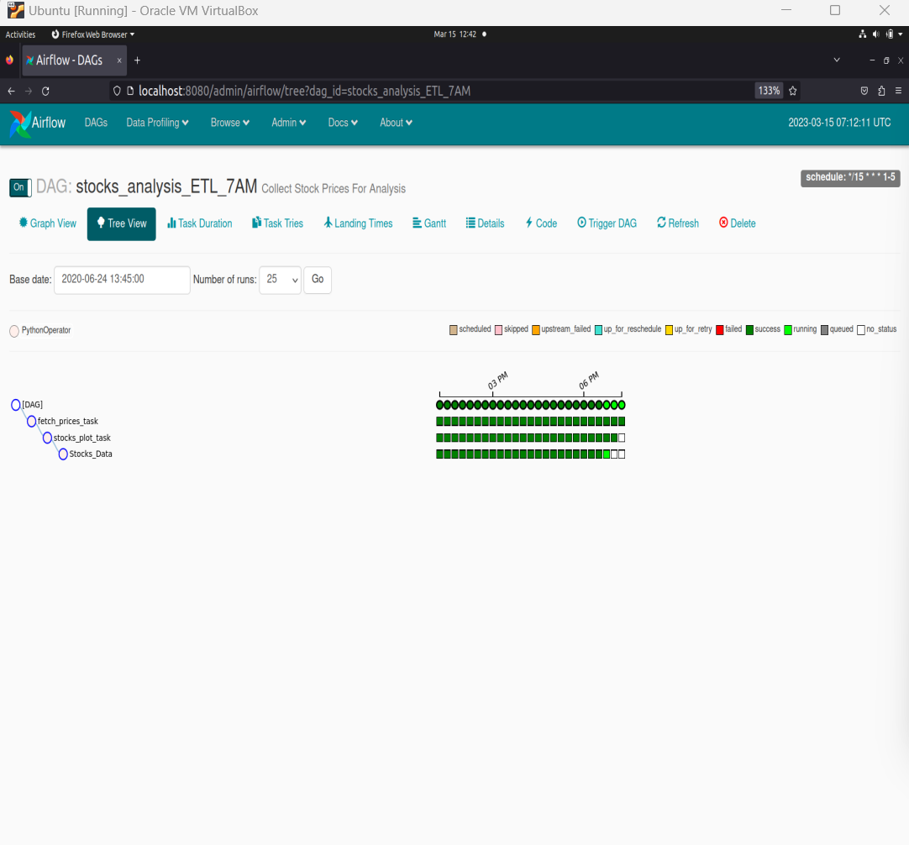
IMPLEMENTATION
In the linux Virtual machine : Installed Python , Mongo DB nd AIRFLOW
We have written a code with time lines, columns and saved in the form of .py extention used it as a DAG (Directed acrylic graph)
D:\sharedfolder\Airflow\stocks.py
COMMAND USE(LINUX os terminal) : a) Airflow webserver (for triggering the dags and also for user interface)
B) airflow scheduler ( for scheduling the dags for certain time intervals)
C) Mongo ( for starting the mongo shell)

Slide 15
MACHINE LEARNING AND FLASK
After the data extraction then we have done machine learning models like linear regression , decision trees , random forest regressor , k nearest neighbor and LSTM algorithms with in a py file :
Python code : utils.py
Then we have procedded with the flask application preparation with the help of connectors from python to the flask library the code is thus saved as “app.py”
Python code : ..\Stock-Prices-Prediction-ML-Flask-Dashboard-master-20230301T165820Z-001\Stock-Prices-Prediction-ML-Flask-Dashboard-master\app.py
Finally the codes are executed in the terminal i.e here we have used “ANACONDA POWER SHELL PROMT” which is fast and also effective
COMMAND USED : python app.py

Slide 16
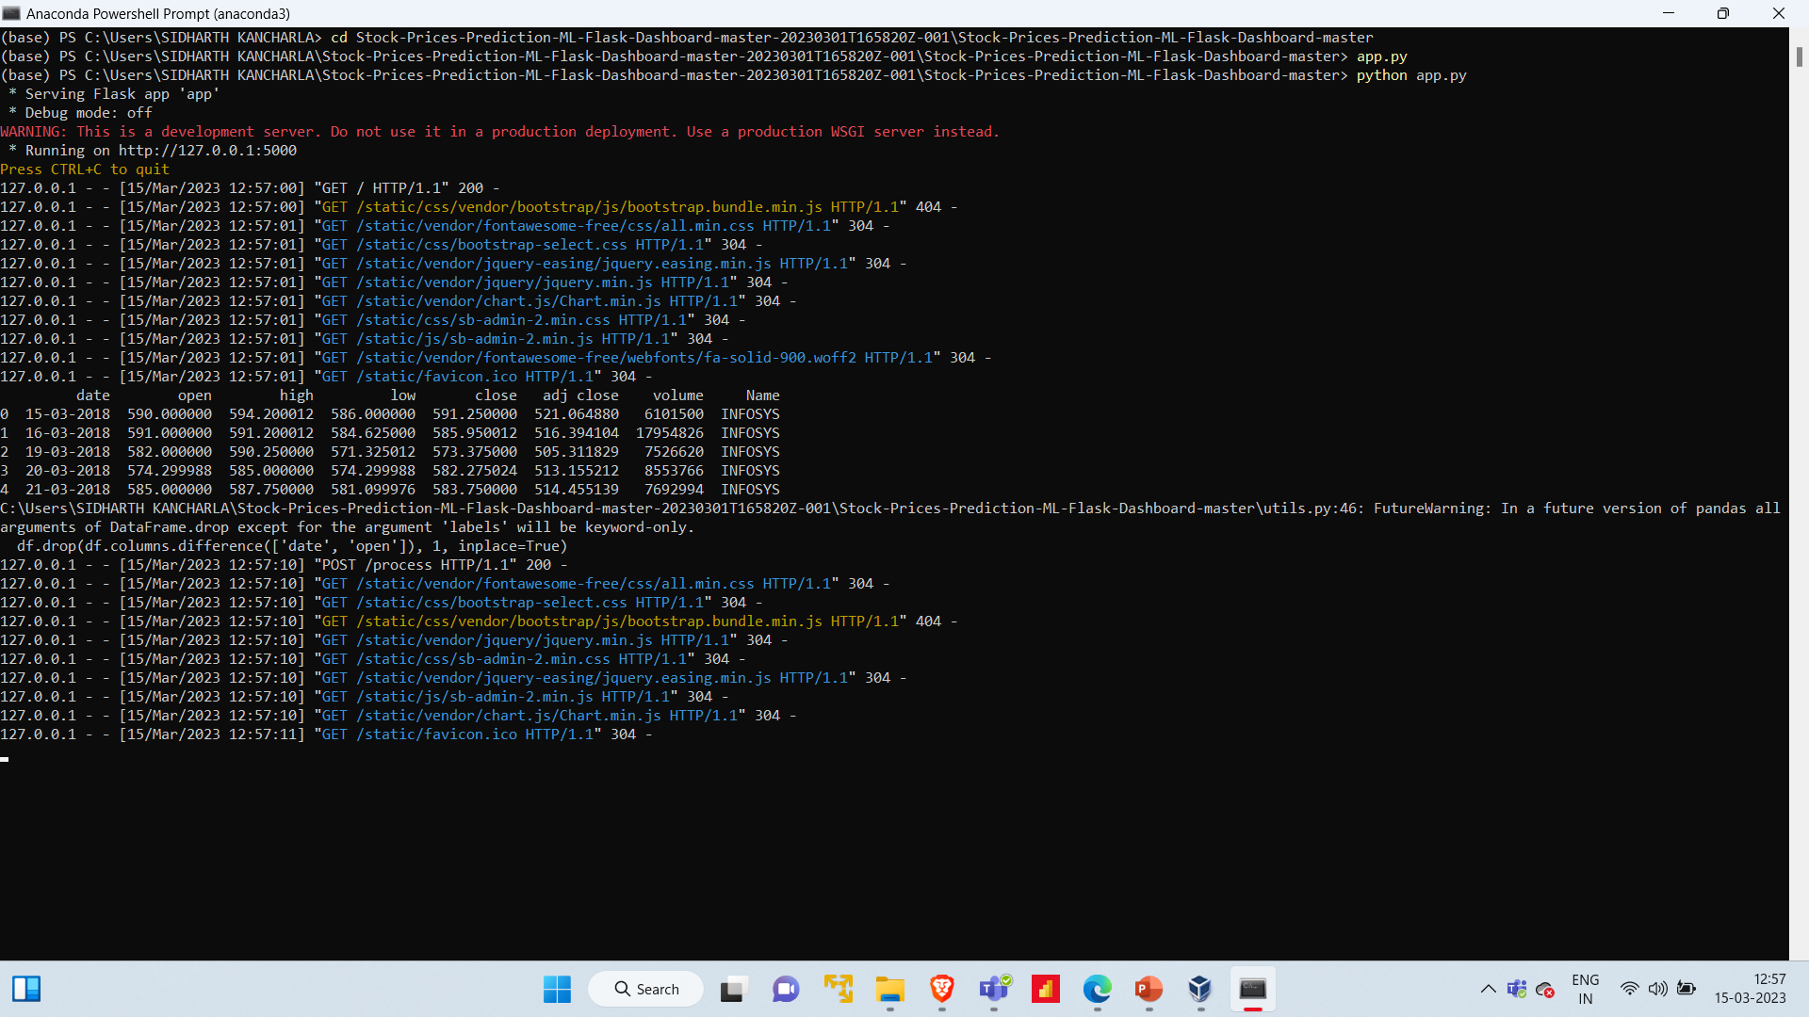
RESULTS and OUTPUT

Slide 17
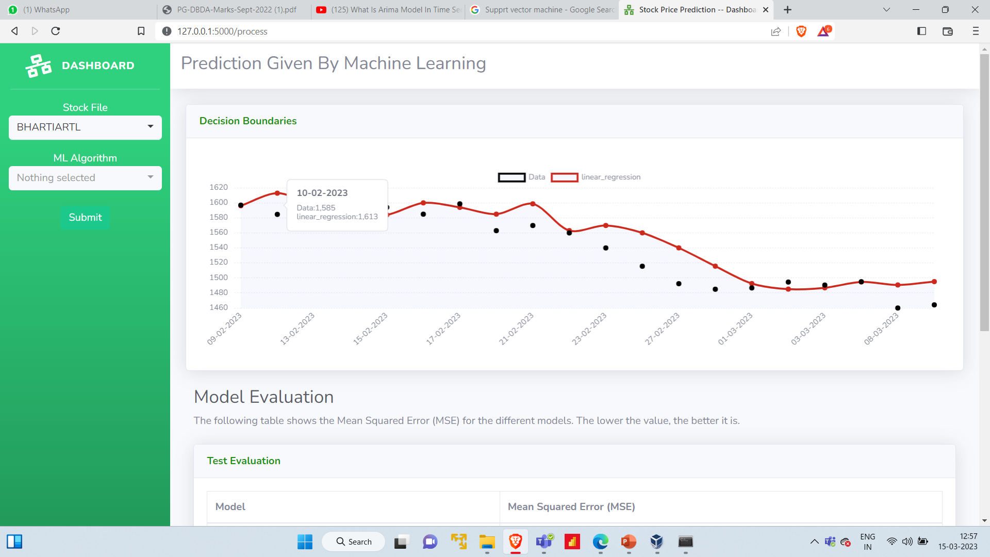
User Interface web application

Slide 18
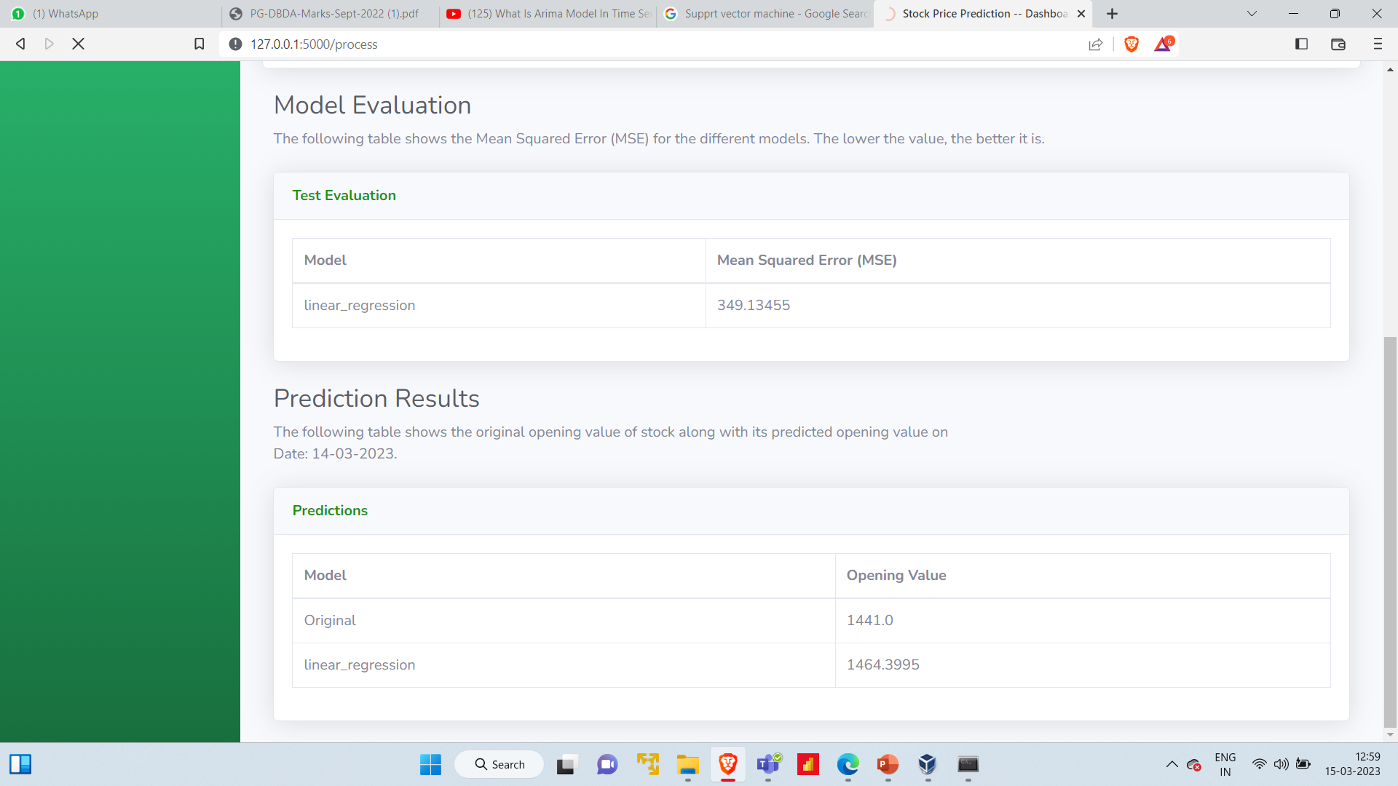
MODEL EVALUATION RESULTS

Slide 19
CONCLUSIONS
1. We here have created an abstract for the stock price predictions with the help of different machine learning models and then we have seen the errors, actual price and predicted prices.
2. Thus this makes an user to get a clear idea about a stock price in Future
3. After this predicted price an investor may decide where to invest in the above mentioned stocks , so as to this they just put an stock symbol and then check the prices of future or the next day .
4. This makes the investor feel good and doesn’t need any Brokerage fees he/she can save the money further.
5. Stock prices very prone and they are the one who change in the frequency every minute or seconds so as to this we are now living in a globalised era where the technology can equally work as human brain .
6. Machine learning and artificial intelligence has made lifes easier and smarter at the same time .
7. This the small favor in order to save the money for a low grade investors who cannot accommodate a broker
8. Now a days stocks investing has a become a second income for many middle class people , this trial from the project may help them in bigger time.

Slide 20
CREDITS and REFERENCES
PICTURE 1 : https://www.istockphoto.com/?http://esource=SEM_IS_GO_IN_Brand_iStock-Mix_EN&kw=CA_iStock-Photo_Exact_istock+photos_e&kwid=s_43700067636174378_dc&pcrid=562472910412&&
PICTURE 2 : https://www.google.com/search?sxsrf=AJOqlzX-FZeFIEfPchO1d6jKyWC-_fbHCw:1678865539089&q=airflow+logo&tbm=isch&sa=X&ved=2ahUKEwjs19TAtd39AhUK4XMBHXuPA5wQ0pQJegQIEhAB&biw=1707&bih=833&dpr=1.13#imgrc=MtZ48qfwkkd-kM
PICTURE 3 : https://www.google.com/search?q=mongo+db+logo&tbm=isch&ved=2ahUKEwjUnevCtd39AhV
PICTURE 4 : https://www.google.com/search?q=flask+logo&tbm=isch&ved=2ahUKEwiH3N_etd39AhX7iNgFHf4dAWUQ2-cCegQIABAA&oq=flask+logo&gs_lcp=
REFERENCES :
https://airflow.apache.org/docs/apache-airflow-providers-mongo/stable/connections/mongo.html
EDA & MACHINE LEARNING :
https://www.kaggle.com/code/faressayah/stock-market-analysis-prediction-using-lstm
FLASK :
https://drive.google.com/file/d/1iP5RqdlREx_YbP-5RZqo7fB1rElQ2igi/view
https://www.youtube.com/watch?v=UbCWoMf80PY
https://github.com/kaushikjadhav01/Stock-Market-Prediction-Web-App-using-Machine-Learning-And-Sentiment-Analysis

Slide 21

THANK YOU ALL !!
EVERYONE FOR YOUR KIND ATTENTION !!

